Slide 1
Using point cloud data to discover genomic regions associated with dynamic height
Colleen Hunt

Slide 2

Acknowledgment of Country
The University of Queensland (UQ) acknowledges the Traditional Owners and their custodianship of the lands on which we meet.
We pay our respects to their Ancestors and their descendants, who continue cultural and spiritual connections to Country.
We recognise their valuable contributions to Australian and global society.
Notes:
Guidelines for use:
Use this slide when presenting at UQ or at any site in Australia, when appropriate.
Remember to pause briefly after acknowledging Country as a sign of respect.
If you are more familiar with acknowledging Country you may add a statement about the event, meeting or forum’s connection with Country. For example; at a higher education event you might acknowledge that the campus has always been a space for teaching, learning, research and collaboration tens of thousands of years before it was established as a university campus, and continues today.
When to use longer version:
If you are the main speaker at the event/gathering
If you are the first person to present.
When to use a shorter version:
If you are not the first person to acknowledge Country
In a more informal setting
Thanking a Traditional Owner for welcoming people to Country.
Longer version
I acknowledge the Traditional Owners and their custodianship of the lands on which we meet today. (On behalf of *) I pay our respects to their Ancestors and their descendants, who continue cultural and spiritual connections to Country. We recognise their valuable contributions to Australian and global society.
* If you are hosting an event, meeting or seminar, you might say something like “On behalf of the event organisers or your section….”
Shorter version
I (too,) acknowledge the Traditional Owners and their custodianship of the lands on which we meet today and pay my respect to their Ancestors and their descendants.
Slide last updated June 2019 – content owner is PVC(IE)/ATSISU (contact Nell Angus).

Slide 3
Introduction
Many plant breeders measure the height of candidate varieties at harvest time
Potentially there is additional information to be gained from looking at the growth trajectory rather than a single point estimate
The cost of labour precludes measuring height at multiple time points during the growing season
One resource saving method to access this information is to extract height data from UAV images over multiple time points which are inexpensive to capture

Slide 4
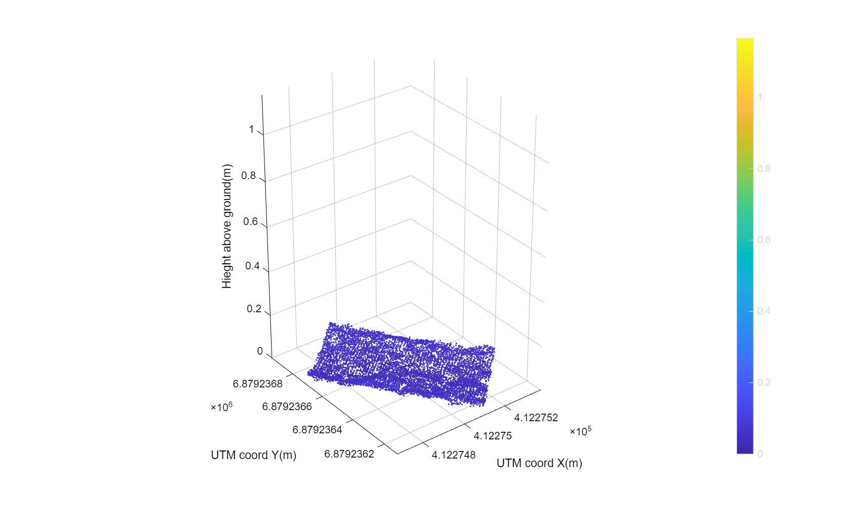
3D point cloud
The images from the drone are converted using photogrammetry software into point cloud that enables the heights to be calculated
98th percentile values were used at each time point
Supplied by Sean Reynolds Massey-Reed

Slide 5
Aim
In this talk I will concentrate on early growth
Develop traits that represent the growth pattern
Early Growth
Maximum Growth (comparable to the height at harvest)
Rate of growth
Analyse these traits for genetic differences
Genetic variance
Genotype patterns
Genomic prediction
GWAS to find associated genomic regions

Slide 6
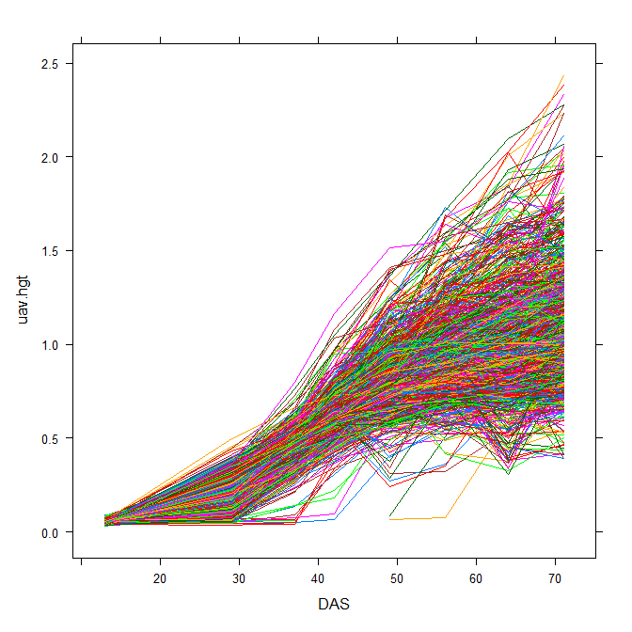
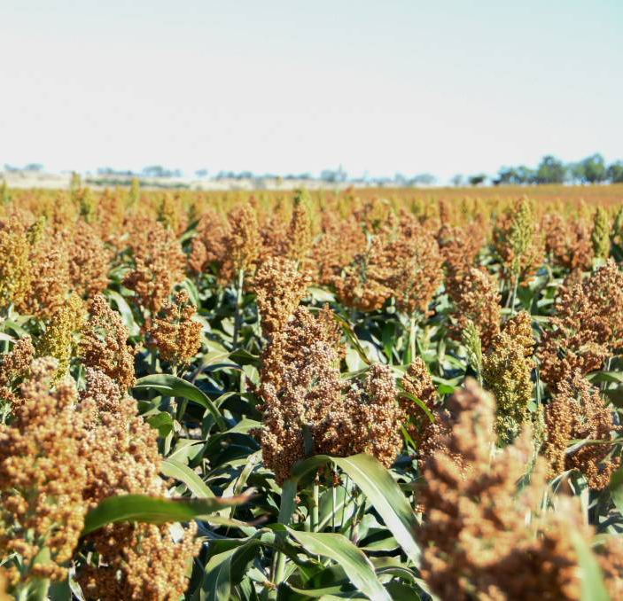
Data
2021 Sorghum Trial at Warwick Qld
N=1190 Plots, 35 Columns, 34 Rows
881 Genotypes, mostly inbred lines, some parents, some commercials
781 are genotyped
~1.8M SNPs
8 drone flights at days 13,29,37,42,49,56,64,71

Slide 7
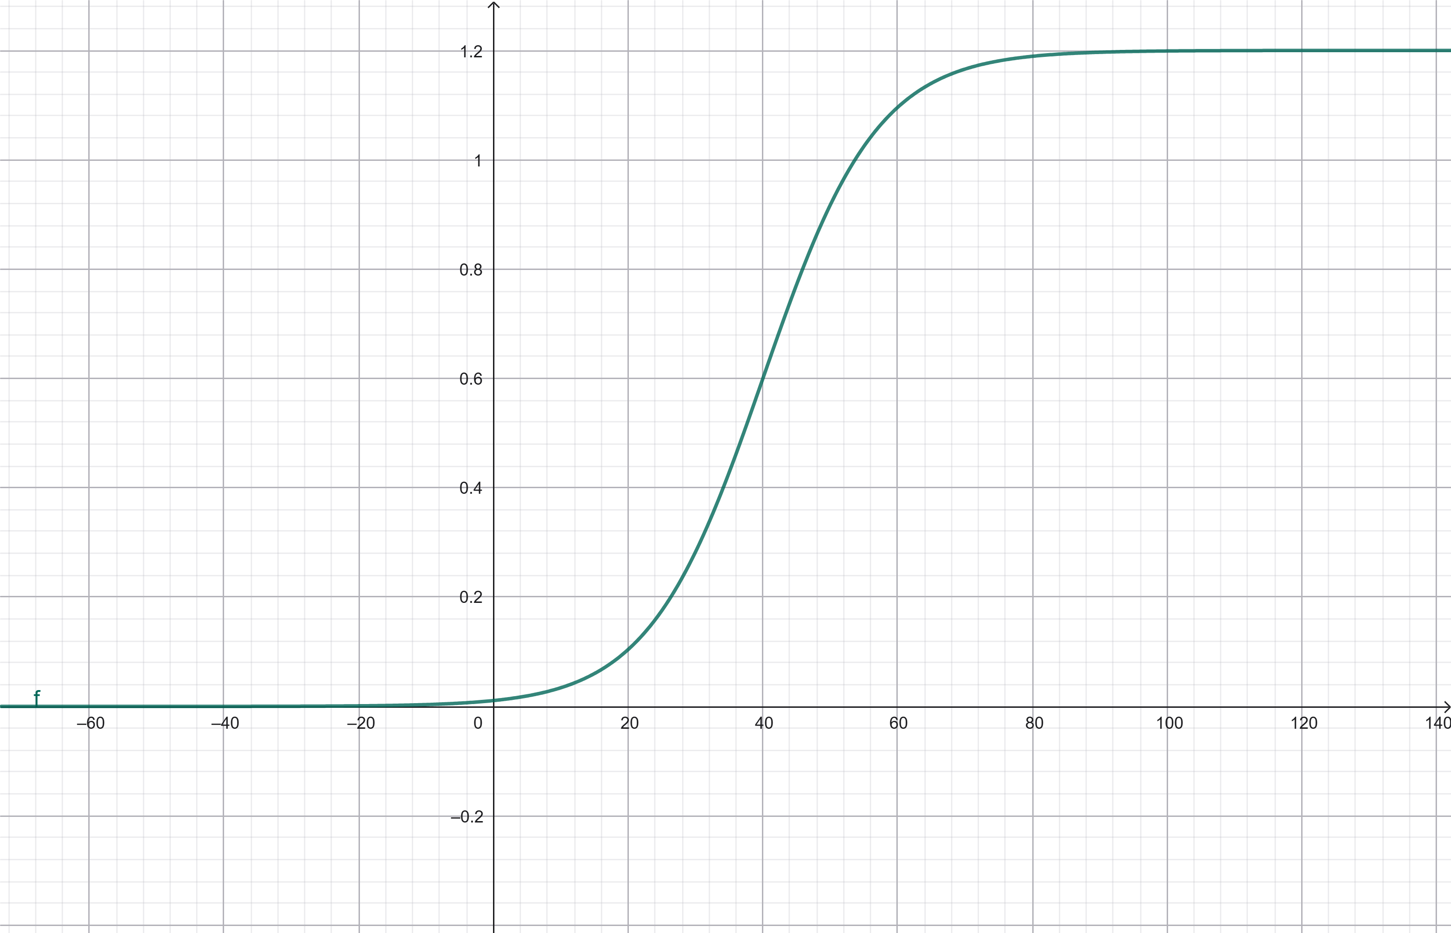
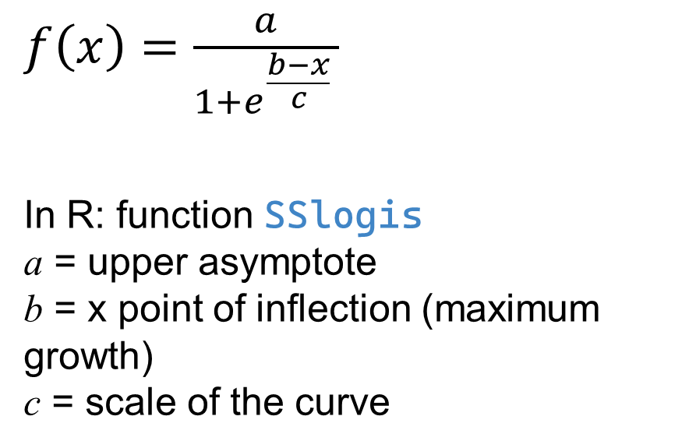
Sigmoidal
$f\left(x\right)=\frac{a}{\begin{aligned}1+e^{\frac{b−x}{c}} \\ \end{aligned} }$
In R: function SSlogis
a = upper asymptote
b = x point of inflection (maximum growth)
c = scale of the curve
Plant Height (m)
Days after sowing (days)

Slide 8
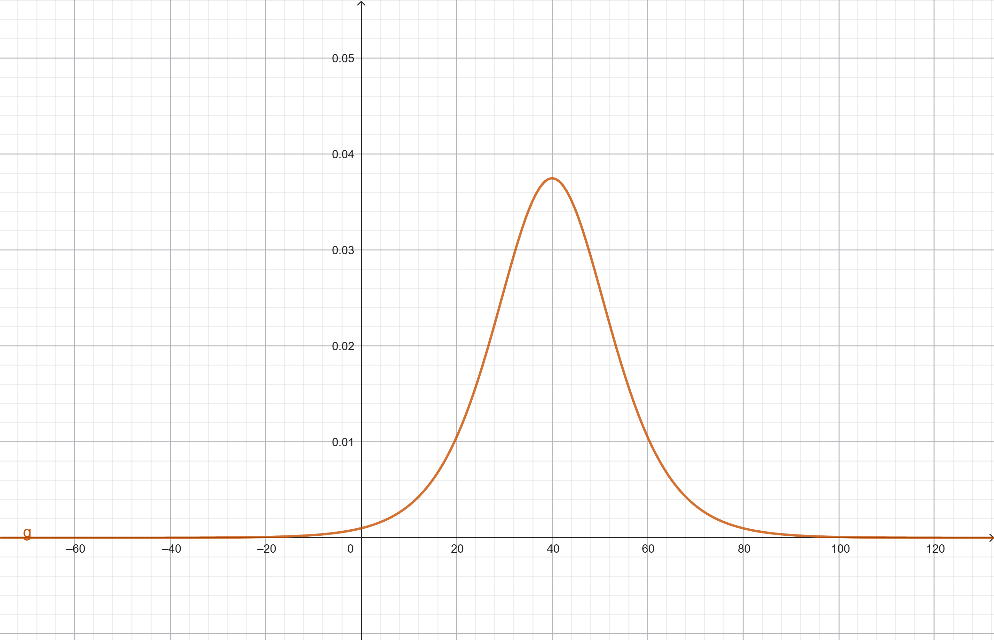
Sigmoidal
The first derivative resembles a Normal distribution
The location we are looking for is the third derivative
In Physics terms:
F’(x) = height/time = velocity
F’’(x) = velocity/time = acceleration
F’’’(x) = acceleration/time = jerk
In Physiology terms:
Onset of a rapid growth phase
Transition between acceleration and deceleration
The third derivative of the growth curve indicates the timing and magnitude of changes in growth acceleration and can help identify critical transition points in development.
Plant Height velocity (m/day)
Days after sowing (days)

Slide 9
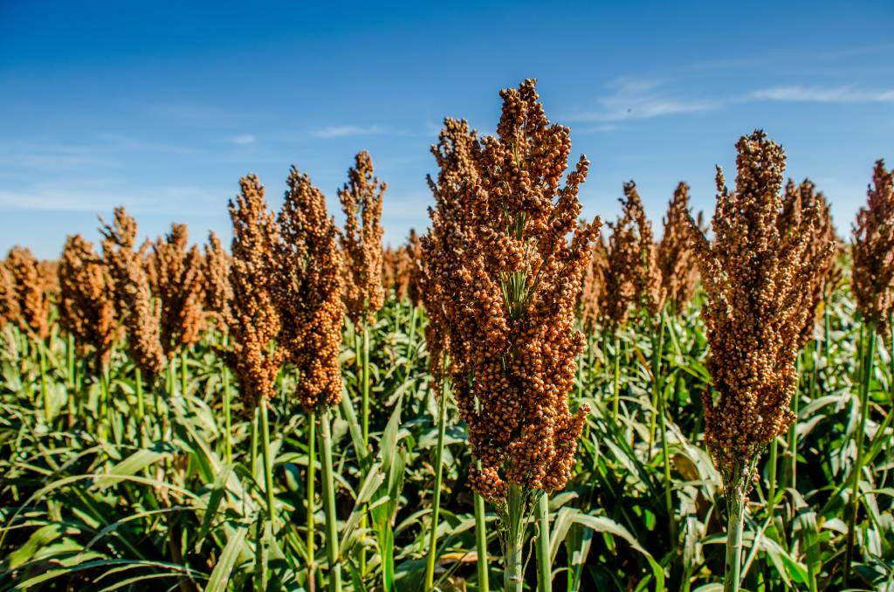
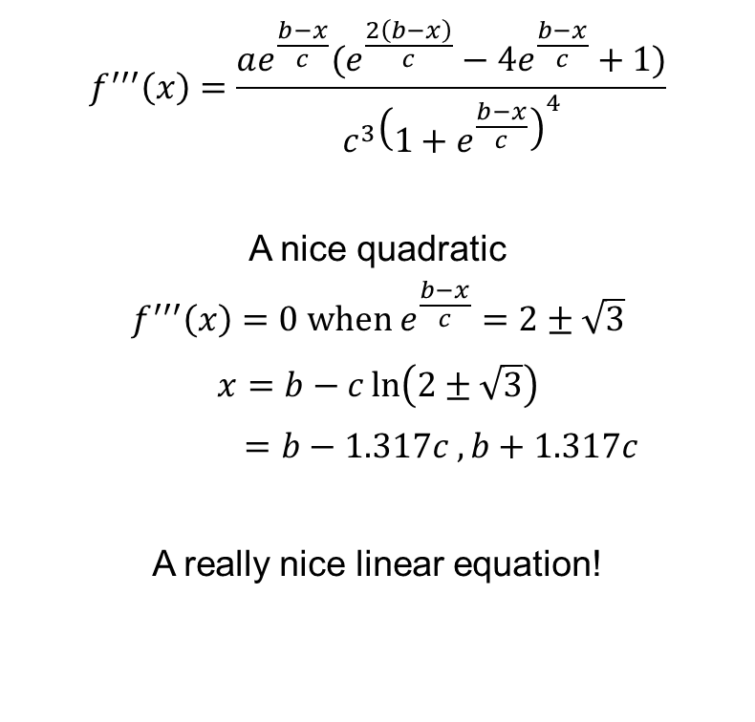
Third Derivative
$$f^{′′′}\left(x\right)=\frac{ae^{\frac{b−x}{c}}(e^{\frac{2\left(b−x\right)}{c}}−4e^{\frac{b−x}{c}}+1)}{c^{3}{\left(1+e^{\frac{b−x}{c}}\right)}^{4}}$$
A nice quadratic
$$f^{′′′}\left(x\right)=0 \text{when} e^{\frac{b−x}{c}}=2±\sqrt{3}$$
$$x=b−c\ln\left(2±\sqrt{3}\right)$$
$=b−1.317c , b+1.317c$
A really nice linear equation!

Slide 10
Fitting the data
Parameters:
Estimate Std. Error t value Pr(>|t|)
a 1.3333 0.0293 45.50 9.68e-08 ***
b 41.3000 0.5857 70.52 1.09e-08 ***
c 6.8507 0.5467 12.53 5.75e-05 ***
For each plot there are 8 time points so we can fit SSlogis to each plot and then use these results to make a jerk variable for each plot.
So you’re fitting a line to a single set of points?
Yes
But I’m doing that 1190 times!!
At the end I will have 1190 of each of the 3 parameters, 1190 standard errors of each of those and 1190 residual mean squares.

Slide 12
No it didn’t work for all of them
Out of 1190 plots only 10 completely failed

Slide 13
Distribution of jerk

Slide 14
Linear Mixed Model
Jerk is the trait
Opportunity to fit a fancy residual as AR1 over time
For now, a weighted analysis using the standard errors from each logit
 | Genotype | Genomic Prediction
REML logl | -2303.317 | -2280.154
Row | 0.427 | 0.413
Column | 1.490 | 1.451
NotGeno | 11.430 | 11.638
Additive Genetic |  | 4.176
Ide Genetic | 9.372 | 5.740
Residual | 1.792 | 1.668
Row AR1 | 0.562 | 0.497
avSED | 2.609 | 2.543
Generalised H² | 64 | 67

Slide 15
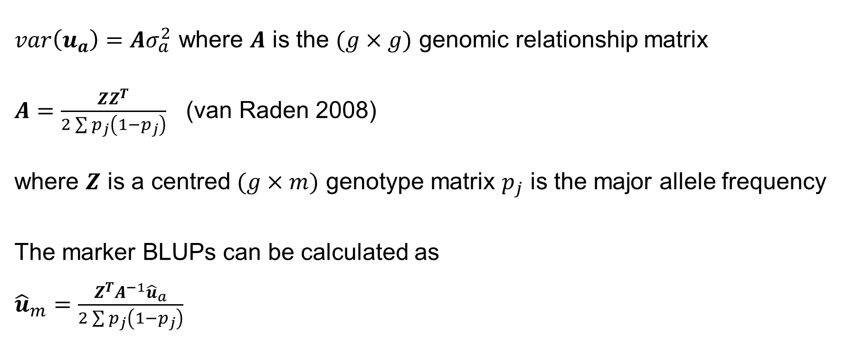
Transforming gBLUPs into Marker BLUPs
$var\left(u_{a}\right)=Aσ_{a}^{2}$ where $A$ is the $(g×g)$ genomic relationship matrix
$A=\frac{ZZ^{T}}{2\sum{p_{j}\left(1−p_{j}\right)}}$ (van Raden 2008)
where $Z$ is a centred $(g×m)$ genotype matrix $p_{j}$ is the major allele frequency
The marker BLUPs can be calculated as
${\hat{u}}_{m}=\frac{Z^{T}A^{−1}{\hat{u}}_{a}}{2\sum{p_{j}\left(1−p_{j}\right)}}$

Slide 16
Jerk Marker BLUPs
Height Genes

Slide 17
Conclusions
Growth profiles can be estimated using imaging from weekly UAV flights
Having an equation for each plot enables accurate predictions for time points for each plot
The trait can successfully be analysed as a trait using weights to ensure that the fit of the plot equation is taken into account
Jerk – the onset of sudden growth – was shown to be a moderately high heritable trait
There is promising signs that genetic signals may be present in unique parts of the genome

Slide 18


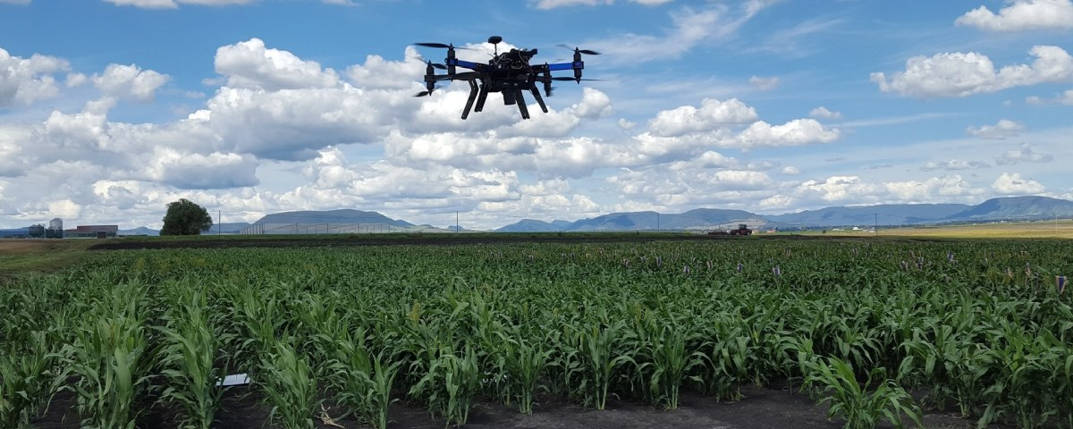
Acknowledgements
Co-Authors
Prof. Emma Mace
Prof. David Jordan
Photographers and image analysis
Ken Laws
Sean Renolds Massey-Reid
Hermitage Sorghum Research Team

